Slide 1
“Rotating Your Lineup” How Does Housing Support Talent Management?

Slide 2
“Rotating Your Lineup” How Does Housing Support Talent Management? Panelists
Sylkia Negron, MBA, SCRP, SGMS – Global Mobility Supervisor | Global Mobility Services, TechnipFMC plc
Mary Ann Passi, CAE – CEO, Corporate Housing Providers Association
Julie Rice -Senior Global Advisor, Strategic Alliances – Mobility, National Corporate Housing

Slide 3
2016 Overview
$3.1 billion US industry
Units: US 68,757
Average Stay (nights): US 86
Occupancy: 86.6% US
US: Relocation #1; Project/Training #2
ADR: US $149.75 5.8%

Slide 4
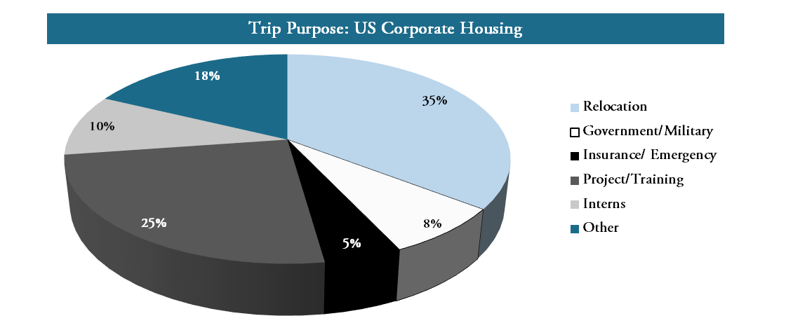
Purpose of Trip - US
Notes:
MAP: Discuss growth of various sectors for the last 5 years – compare/contrast in comments. Any large trends.

Slide 5
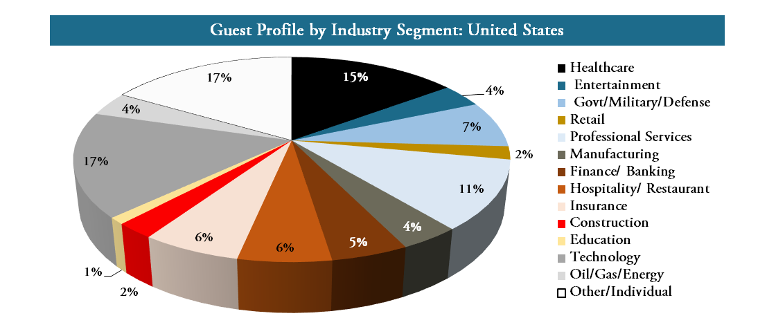
Guest Profile by Industry - US
Notes:
MAP: Growth – shift of industries. Any large trends.

Slide 6
Key Midwest Markets
Chicago Metro 62 days $142
Loop (57 days/$145) & Suburbs (96/$126)
Detroit 73 days $112
Indianapolis 86 days $112
Milwaukee $118
Minneapolis 84 days $113
St. Louis 115 days $101

Slide 7
Industry Noise
Notes:
MAP: Lots of media attention. We are not the nuisance. Getting swept up and confused with legislation trying to regulate the sharing economy and other short term rental industries.

Slide 8
Understand Differences
Professionally Managed B2B model
Mitigate risk
Service Expectations
24/7 on call
Abide by:
Tax codes
Property zoning laws
Health/safety codes
Lease restrictions
Local regulations

Slide 9
Understand Differences
Economic Impact
Local Employers
Know Communities
Residential Space near Businesses
Support:
Interns → CEOs
Other Destination Service Needs
24/7 on call needs
Employee productivity/comfort

Slide 10
Career Road Map Supporting a Housing program to Develop Leadership
Flexible Programs
Variety of Housing Options
Company Culture and Demographics
Policy Changes/Exceptions
Assistant
Team
Leader
Sr
Associate
Team
Leader
Intern
Associate
Manager
Vice Pres

Slide 11
Supporting an Integrated Housing program
Intern Programs
Travel
Recruiting
Rotational Programs
Co-op
Temporary Assignments
Long Term Assignments
Leadership Training
Projects
Training

Slide 12
Case Study Fortune 500 Client
Scenario:
Company moved a large sector of their population ever 1-2 years and offered temp housing and home sale/purchase program
Business Issue:
They were losing 100,000’s assisting with selling and purchasing home because they kept moving the same people
Solution:
Offered Corporate Housing and 3 days of unfurnished assistance
Extended the home purchase program and saved them $100,000’s

Slide 13
Questions and Thank You!

