Slide 1
Home Sale Programs – Make it a Home Run!

Slide 2
Home Sale Programs Make it a Home Run! Panelists
Mitch Ulrich, CRP
SVP – Global Mobility Strategies
NEI Global Relocation
Katrina Evans, CCP
Director of Global Compensation & Mobility
Oshkosh Corporation
Rebecca Glatzhofer, GMS
Business Development
Crown World Mobility

Slide 3
2016 Home Sale Transactions

Slide 4
2016 Types of Home Sale Transactions
Increase of 64% over 2014
Buyer Value Option
(BVO)
Guaranteed Buyout Option
(GBO)
Totals may not equal 100 due to rounding

Slide 5
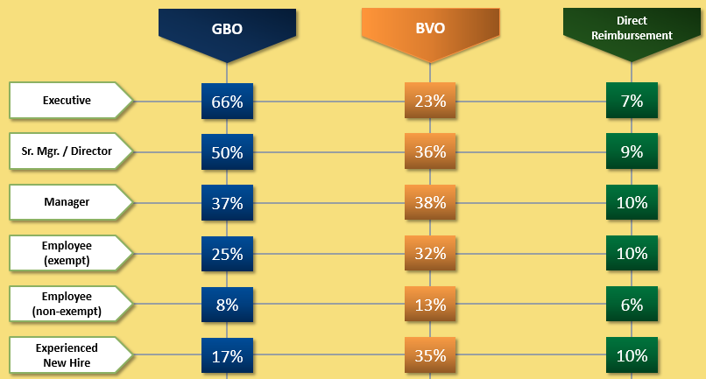
Eligibility for Home Sale Programs by Position

Slide 6
Guaranteed Buyout Program
(GBO)

Slide 7
IRS Revenue Ruling 2005-74
Applies to Guaranteed Buy Out (GBO) Programs
11 Key Elements (see handout)
Two separate sales
1st Sale: Employee to Relocation Management Company
2nd Sale: Relocation Management Company to Outside Buyer

Slide 8
Cost Control Strategies
List
Price
Restrictions
Home
Sale
Bonus
Required
Marketing
Period
Mandatory
Approved
Broker

Slide 9
Accepting Offers < Appraised Value
*Other includes: 90% of Established Value; With Approval Only

Slide 10
Home Sale Bonus/Incentive

Slide 11
List Price Restrictions
Seventy-five percent (75%) of companies with GBO programs
Include list price restrictions
20%
60%
2%
18%

Slide 12
Mandatory Marketing Periods
Seventy-nine percent (79%) of companies have
required marketing periods
30
Days
60
Days
90
Days
120
Days
180
Days
2%
28%
58%
10%
2%

Slide 13
Use of Approved Brokers
Most companies, 88%, require the use of approved brokers. Of those, 73% reduce benefits when an approved brokers are not used.
Totals may not equal 100 due to rounding

Slide 14
Buyer Value Option Program
(BVO)

Slide 15
Ineligible Home Benefits

Slide 16
Home Sale Program Costs Comparison
 | Direct Reimbursement | Buyer Value Option | Amended Value Sale | Guaranteed Buy Out
Established Value | $ 367,000 | $ 367,000 | $ 367,000 | $ 367,000
Acquisition Costs |  | $ 1,000 | $ 2,000 | $ 2,000
Holding Costs (Est. 1.5%/mo.) |  | $ 3,000 | $ 3,000 | $ 22,000
Avg. Resale Loss (Est. 5%) |  |  |  | $ 18,000
Selling Costs (Est. 8%) | $ 30,000 | $ 30,000 | $ 30,000 | $ 30,000
Gross-Up (Est. 62%) | $ 18,600 | $ 0 | $ 0 | $ 0
Total Est. Costs | $ 48,600 | $ 34,000 | $ 35,000 | $ 72,000

Slide 17
Questions and Thank You!

