Slide 1
“Don’t Strike Out” Tax, Compensation and Immigration 101

Slide 2
“Don’t Strike Out” Tax, Compensation and Immigration 101 Panelists
Gabriele Bachhuber, GMS
Fiserv, Inc.
Senior Consultant, HR Operations, Global Mobility Human Resources
Phone: 262.879.5904 Email: Gabriele.Templet@Fiserv.com
Jennifer Stein
GTN Great Lakes
Managing Director
Phone: 312.698.9864 Email: jstein@gtn.com

Slide 3
Agenda
Case Study of a long term assignment
India to the U.S.
Immigration considerations
Tax & compensation considerations

Slide 4
Case Study Overview
Chennai, India to Chicago, IL
Company has operations in India and the U.S.
Assignment for a Senior Software Developer
Estimated three year assignment; tax equalization to India
Married with two children, all relocating to US

Slide 5
Immigration – Where to Start
Understand the specifics
What is the U.S. role (job)? How long?
What experience does the employee have?
What is our timeline? Budget?
What are the family needs?

Slide 6
Immigration – What are the options?
B-1 – Meetings & receiving training
H-1B – Specialty occupation/lottery
L-1B – Specialized knowledge
L-1A – Managerial
TN – Mexico or Canada citizenship
F-1 – Student
J-1 – Training

Slide 7
Immigration – Visa Identified
L-1B
Challenges
The consulate experience for Indian nationals (“DMV”)
More difficult path to a Green Card for long term needs
Advantages
Valid for a total of 5 years
Spouse can apply for work authorization

Slide 8
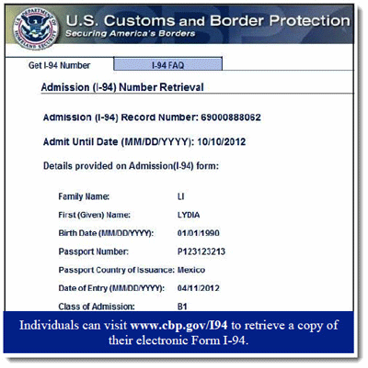
Immigration – Visa approval
Entry: What is the I-94?
Tracking the I-94 with each entry
Passport cutoffs for
employee and family
Generally used for I-9 verification
Extension after 3 years
The USCIS experience vs. the Consulate

Slide 9
Immigration – Permanent Intention
Change status from L-1B to H-1B (lottery)
Start Permanent Residency (“Green Card”)
Wait and extend, wait and extend…
Employment Based | All Charge- ability Areas Except Those Listed | CHINA- mainland born | EL SALVADOR GUATEMALA HONDURAS | INDIA | MEXICO | PHILIPPINES
1st | C | C | C | C | C | C
2nd | C | 15DEC12 | C | 01JUN08 | C | C
3rd | 01DEC16 | 15MAR14 | 01DEC16 | 22MAR05 | 01DEC16 | 15MAR12

Slide 10
Managing Immigration: Tips
Have a centralized process
Get your name out
Have one law firm
Have a good law firm
Have a system of renewing work authorization
Have a system of starting Green Cards
Keep track of Employment Authorization Document (EAD)
Keep key dates in email subject lines

Slide 11
Taxation – Where to Start
Intent
Duration of assignment
Connection between immigration and taxation

Slide 12
F, J, M & Q Visa Holders
Students / trainees / cultural exchanges
Individual treated as nonresident
Days of presence don’t count toward substantial presence test (with time limits) for these visa categories
Compensation exempt from federal tax:
Paid by foreign employer and
Not borne by U.S. office
Applies to F, J & Q visa holders
Exemption applies to social security tax
Filing requirements exist
Form 1040NR & Form 8843

Slide 13
Types of Reimbursement Policies
Reimbursement Policies
Tax Equalization
Tax Protection
Laissez Faire (a.k.a. do nothing)
Hybrid approach

Slide 14
What is Compensation?
Companies typically create policies to address:
Differences in home & host country costs (e.g., housing and COLA)
Tax reimbursement methodologies
Relocation considerations
Performance or location incentives

Slide 15
Compensation – Example Package
 | Home |  | Assignment
Salary | $ 80,000 |  | $ 80,000
Bonus | 15,000 |  | 15,000
G&S differential |  |  | 24,000
Automobile |  |  | 12,000
Home leave |  |  | 20,000
Education |  |  | 18,000
Home tax reimbursement |  |  | 2,000
Host tax reimbursement |  |  | 75,000
Hypothetical tax withholding |  |  | -13,000
Housing norm |  |  | -16,000
Host housing cost |  |  | 60,000
 | $ 95,000 |  | $ 277,000

Slide 16
Payroll Considerations
Payroll Considerations
Home
Host
Split payroll
Hypothetical withholding
Social tax
Income tax treaties

Slide 17
Social Security Taxation
General rule: tax applies for U.S. services
Use of Totalization agreements
Eliminates dual taxation
Eliminates dual coverage
Certificate of coverage
See: http://www.ssa.gov/international/ and http://www.ssa.gov/coc

Slide 18
Social Security Agreements
The United States has bilateral Social Security agreements with the following 26 countries:
Australia Austria Belgium Canada
Chile Czech Republic Denmark Finland
France Germany Greece Hungary Ireland Italy Japan Korea (South) Luxembourg Netherlands Norway Poland Portugal Slovak Republic Spain Sweden Switzerland UK
Agreements pending:
Mexico (signed June 29, 2004, but not in force); Brazil – signed June 30, 2015

Slide 19
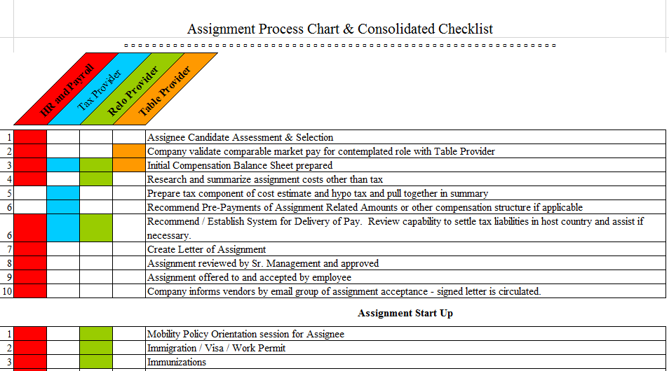
Sample Checklist

Slide 20
Questions and Thank You!

